Slide 1
CyberGuard:Advanced Machine Learning Model for Anticipating and Preventing Cyber Hacking Breaches Using Random Forest and Multi-layer Perceptron

Slide 2
Abstract
"Cyber-Guard" presents an innovative machine learning framework designed to proactively anticipate and mitigate cyber-hacking breaches. Leveraging the capabilities of Random Forest and Multi-Layer Perceptron (MLP) algorithms, Cyber-Guard employs advanced pattern recognition and classification techniques. Through the synergy of Random Forest's ensemble learning and MLP's deep neural network architecture, Cyber-Guard analyzes data patterns to detect and prevent potential cyber threats. This abstract highlights Cyber-Guard's adaptability. continuous leaming, and robust defense mechanisms, ensuring the protection of critical systems and sensitive data against evolving cyber threats.
Keywords: Machine learning framework, cyber-hacking breaches, Random Forest, Multi Layer Perceptron, pattern recognition, cyber threats, data protection

Slide 3
Introduction
"Cyber-Guard" is an innovative machine learning framework designed to anticipate and mitigate cyber-hacking breaches. By leveraging the capabilities of Random Forest and Multi-Layer Perceptron (MLP) algorithms, it utilizes advanced pattern recognition and classification techniques to detect and prevent potential threats. The synergy between Random Forest's ensemble learning and MLP's deep neural network architecture allows Cyber-Guard to analyze complex data patterns accurately. Its adaptability and continuous learning ensure robust defense mechanisms against evolving cyber threats, making it a crucial tool for protecting critical systems and sensitive data.

Slide 4
Existed Method
Signature-Based Detection: This method relies on known patterns of malicious activity, known as signatures, to identify threats. Antivirus programs and intrusion detection systems commonly use this approach. While effective against known threats, it struggles with new, unknown threats (zero-day attacks).
Behavioral Analysis: This method involves monitoring the behavior of applications and systems to identify unusual activity that could indicate a threat. It is effective for detecting sophisticated attacks that do not rely on traditional signatures.
Heuristic-Based Detection: Heuristic detection involves the use of algorithms to identify suspicious behavior by evaluating the context and behavior of files and processes. It can detect variants of known threats but may not be as effective against entirely new attack vectors.
Anomaly-Based Detection: Anomaly-based detection systems establish a baseline of normal behavior and monitor deviations from this baseline to identify potential threats. This method is effective in detecting novel attacks but can generate high false-positive rates if the normal behavior is not well defined.

Slide 5
Disadvantages Of Existing Method
Limited to Known Threats: This method can only detect threats that have been previously identified and cataloged. New, unknown threats (zero-day attacks) go undetected.
Difficult to Define Normal Behavior: In dynamic environments where behavior patterns frequently change, defining what constitutes normal behavior can be difficult.
Difficult to Define Normal Behavior: In dynamic environments where behavior patterns frequently change, defining what constitutes normal behavior can be difficult.
Complex to Implement: Developing accurate behavioral models requires significant effort and expertise.

Slide 6
Proposed Method
Random forest
MLP

Slide 7
Advantages of Proposed Method
High Accuracy in Detection
Robustness Against Overfitting
Versatility in Handling Different Data Types
Adaptability and Continuous Learning
Feature Importance and Interpretability

Slide 8
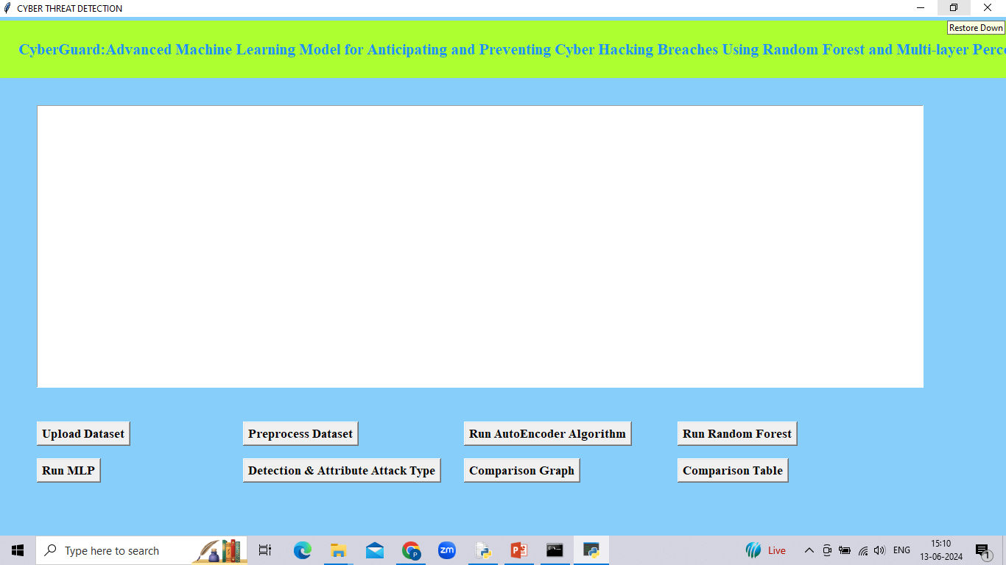
Results : Interface

Slide 9
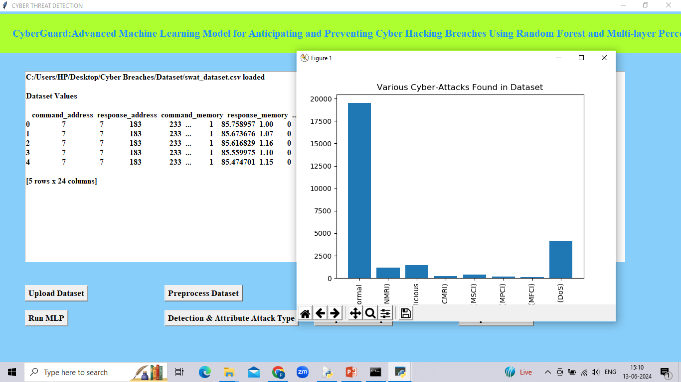
Upload Dataset

Slide 10
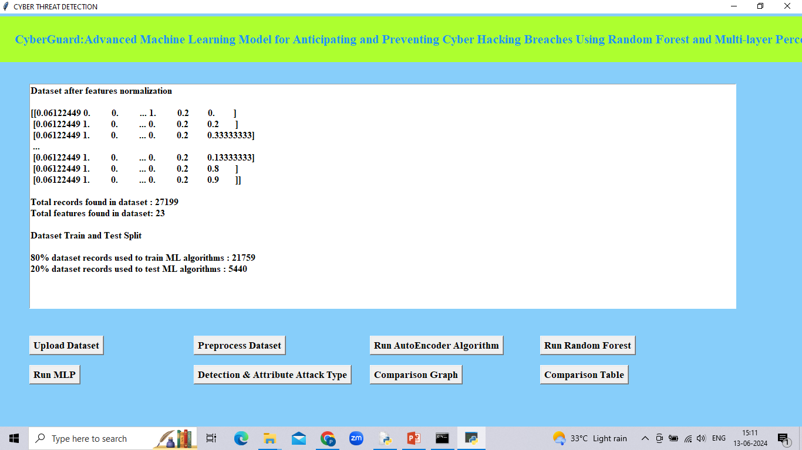
Data Preprocessing

Slide 11
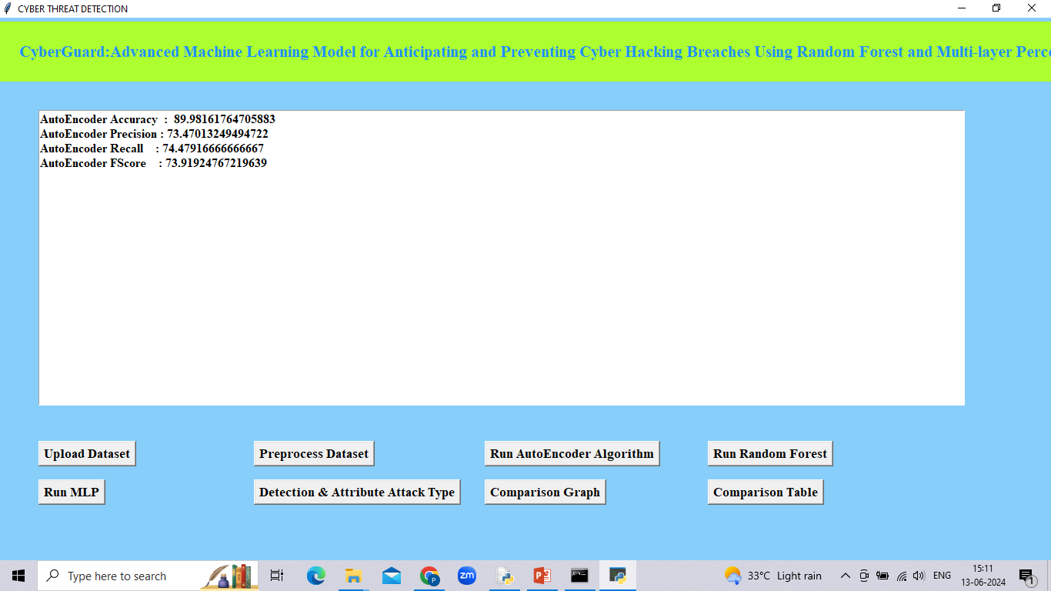
Autoencoder

Slide 12
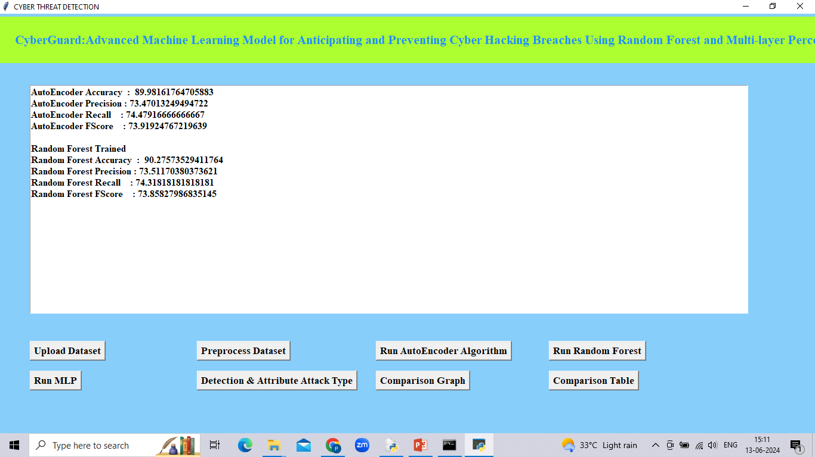
Random forest

Slide 13
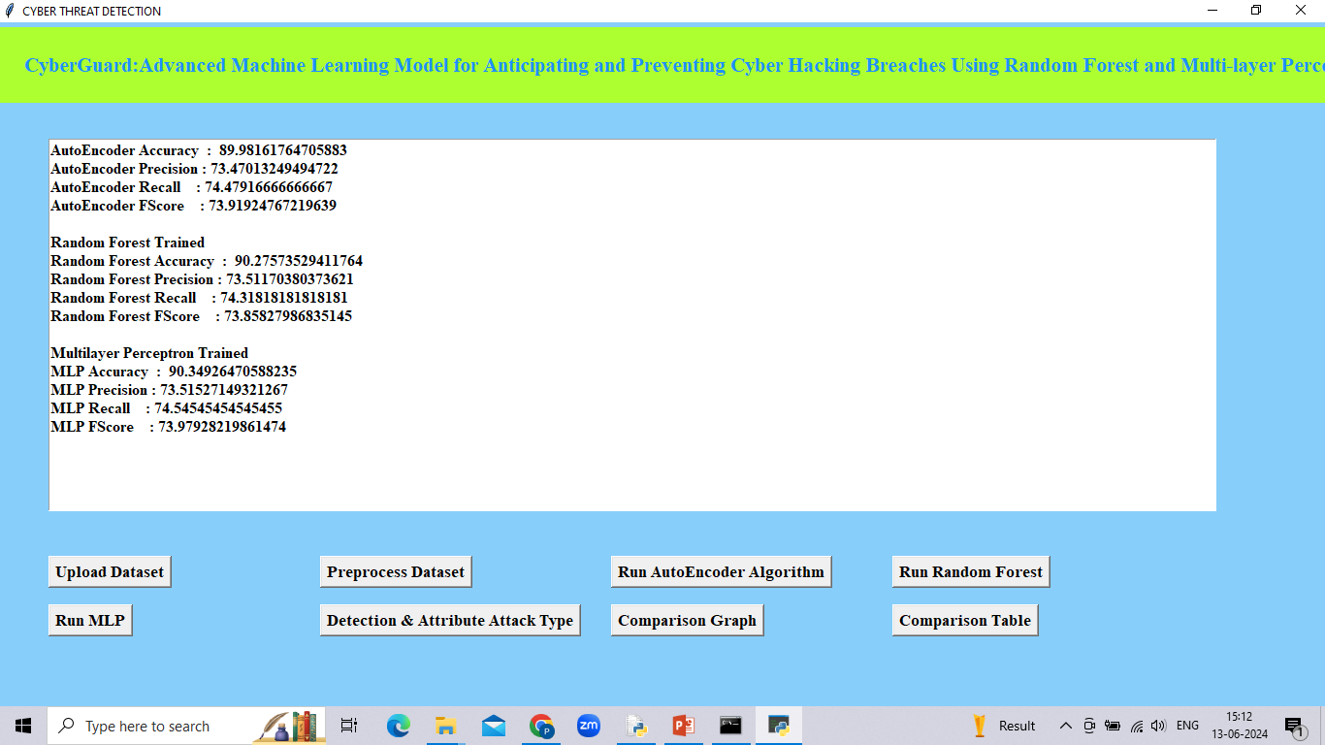
MLP

Slide 14
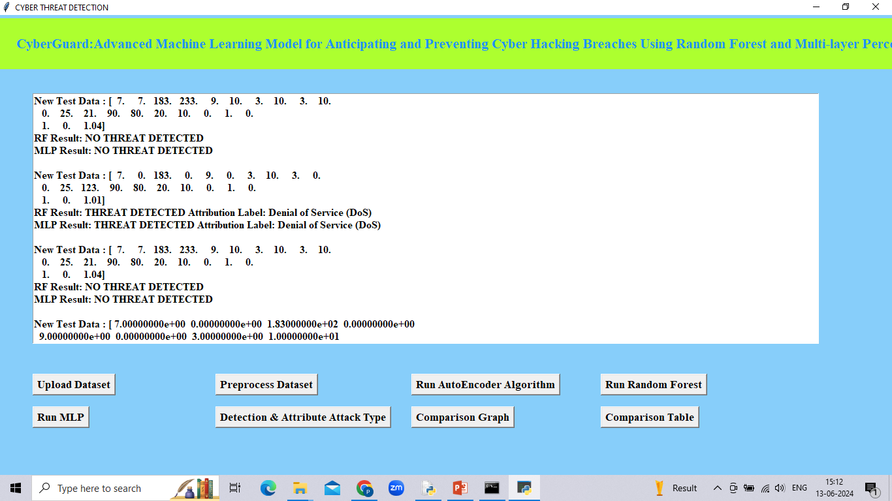
Threat Detection

Slide 15
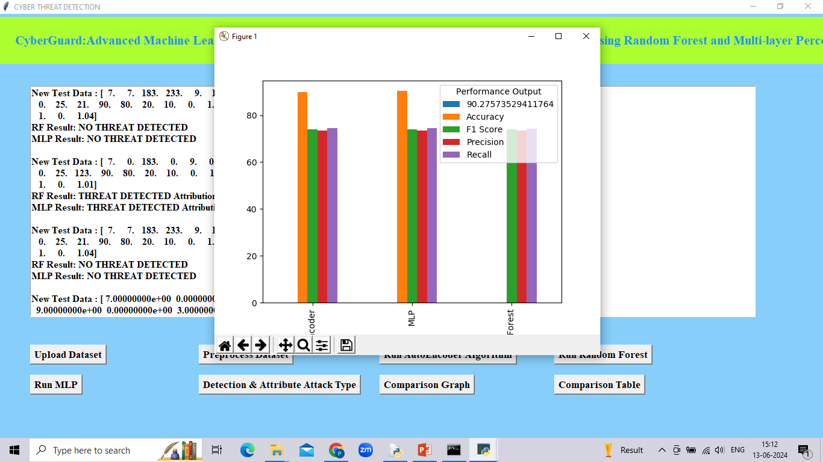
Algorithms Graph

Slide 16
Conclusion
In summary, the integration of Random Forest (RF) and Multi-Layer Perceptron (MLP) algorithms are proposed algorithms to detect threat. This approach enhances detection accuracy, adapts to diverse data types, and fosters robust defense mechanisms against evolving cyber threats. By leveraging RF's ensemble learning for stability and MLP's deep learning for intricate pattern recognition, Cyber-Guard not only detects but also proactively mitigates potential breaches.

